Slide 1

Bsc in Computer Science Engineering
Course: Network and Server Administration
TRANSMISSION CONTROL PROTOCOL (TCP)
Reliable and Connection-Oriented Communication
Name: ABDUR RAHMAN ROKY
ID: 212010078

Slide 2
LEARNING OBJECTIVES
- Understand the fundamentals of Transmission Control Protocol (TCP).
- Learn about TCP's key features and functionalities.
- Explore the TCP header structure and its significance.
- Explain the process of TCP connection establishment and termination.
- Compare TCP with UDP and analyze their differences.
- Discuss TCP flow control and congestion control mechanisms.
- Identify real-world applications of TCP.

Slide 3
AGENDA
1. Introduction to TCP
2. Features of TCP
3. TCP Header Structure
4. TCP Connection Establishment (Three-Way Handshake)
5. TCP Connection Termination
6. TCP vs. UDP
7. Flow Control in TCP
8. Congestion Control in TCP
9. Applications of TCP
10. Advantages & Disadvantages of TCP
11. Conclusion

Slide 4
What is TCP?
- TCP is a connection-oriented protocol that ensures reliable data transmission. Used in various internet applications like web browsing, email, and file transfers.
INTRODUCTION
What is TCP Model?
-The Transmission Control Protocol (TCP) model is a framework for transmitting data between devices over a network. It's a core protocol of the internet.

Slide 5
Protocol means a rule that defines how devices will communicate with each other.
Application
The internet uses a series of different protocols. These protocols are organised into a stack. This is called the TCP/IP model and has four layers that sit on top of each other.
TCP/IP MODEL
Transport
Internet
The layer of protocols exists for each device that is communicating.
Link

Slide 6

Application
Transport
Internet
Link
Various different protocols sit on the application layer, depending on the type of application being used.
The highest layer of the TCP/IP model is where the application sits. The application sends or receives data that is then sent into the rest of the protocol stack.
Examples of protocols:
HTTP
HTTPS
SMTP
IMAP
FTP
The application layer adds header data that can be tracked through the stack.

Slide 7
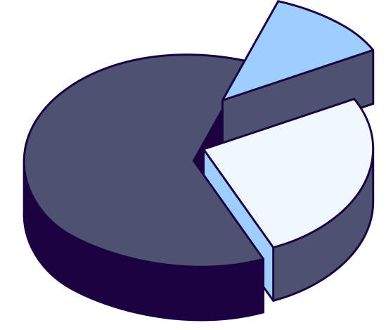
Application
Transport
Internet
Link
Data is passed from the application layer down to the transport layer to be broken into packets. Each packet of data is given a sequence number so that it can be reassembled.
Transmission Control Protocol (TCP)
TCP is a reliable transport protocol because it will always requests again any missing data packets.
User Datagram Protocol (UDP)
UDP is a faster transport protocol but this makes it unreliable because missing data packets are discarded.
Source and destination ports are added to the header.

Slide 8
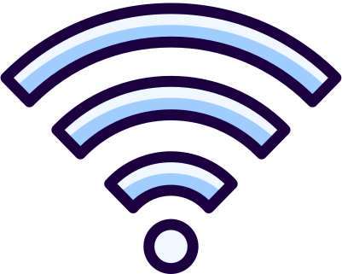
Application
Transport
Internet
Link
The internet layer routes packets of data from one device to another across a network.
Each device is assigned a unique IP (Internet Protocol) address, which identifies the source and destination for data packets.
The internet layer is where the best route is determined for the data packet to get from its source IP address to its destination.

Slide 9
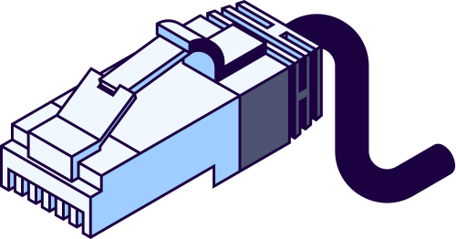
Application
Transport
Internet
Link
The link layer encompasses the protocols of different communicating technologies.
Link layer protocols:
Ethernet
WiFi
Fibre
4G
Satellite
The most common of these protocols is Ethernet, which is used in local area networks. The protocol determines how packets of data are transmitted between devices.
There are a variety of different link layer protocols, some wired and others wireless.

Slide 10
- Connection-oriented protocol.
- Reliable data delivery with acknowledgment.
- Error detection and correction.
- Flow control and congestion control.
- Ordered data delivery.
FEATURES OF TCP

Slide 11
- Source Port & Destination Port.
- Sequence Number.
- Acknowledgment Number.
- Data Offset, Reserved, Flags.
- Window Size, Checksum, Urgent Pointer.
TCP HEADER STRUCTURE

Slide 12
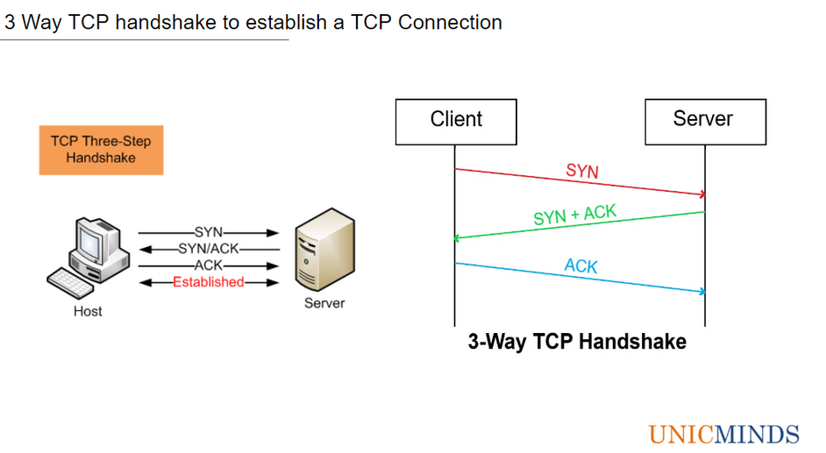
TCP THREE-WAY HANDSHAKE
Step 1: Client sends SYN (synchronize) request.
Step 2: Server responds with SYN-ACK.
Step 3: Client sends ACK to establish connection.
TCP Connection Termination
Step 1: FIN sent by one device to close the connection.
Step 2: ACK received, then FIN sent by the other device.
Step 3: Final ACK received, connection closed.

Slide 13
- Uses Sliding Window Protocol to manage data flow.
- Ensures sender does not overwhelm the receiver.
- Adjusts data transmission rate dynamically.
FLOW CONTROL IN TCP

Slide 14
- Slow Start: Gradually increases transmission rate.
- Congestion Avoidance: Adjusts sending rate to avoid congestion.
- Fast Retransmit: Resends lost packets quickly.
- Fast Recovery: Prevents over-reduction of sending rate.
CONGESTION CONTROL IN TCP

Slide 15
- Web Browsing (HTTP, HTTPS)
- Email (SMTP, IMAP, POP3)
- File Transfer (FTP)
- Remote Access (SSH, Telnet)
- Messaging (WhatsApp, Facebook Messenger)
APPLICATIONS OF TCP

Slide 16
Advantages & Disadvantages of TCP
Advantages
Disadvantages
- Reliable and error-free data transmission.
- Ensures data is received in order.
- Provides flow and congestion control.
- Higher overhead due to acknowledgments and retransmissions.
- Slower compared to UDP.
- Not ideal for real-time applications.

Slide 17
Conclusion
- TCP is essential for reliable communication over the internet.
- It provides error detection, flow control, and congestion management.
- Used in critical applications where data integrity is necessary.
Thank you for your time and attention!

